Slide 1

Chi Square Tests
Chapter 17

Slide 2
Assumptions for Parametrics
Normal distributions
DV is at least scale
Random selection
Sometimes other stuff: homogeneity, homoscedasticity

Slide 3
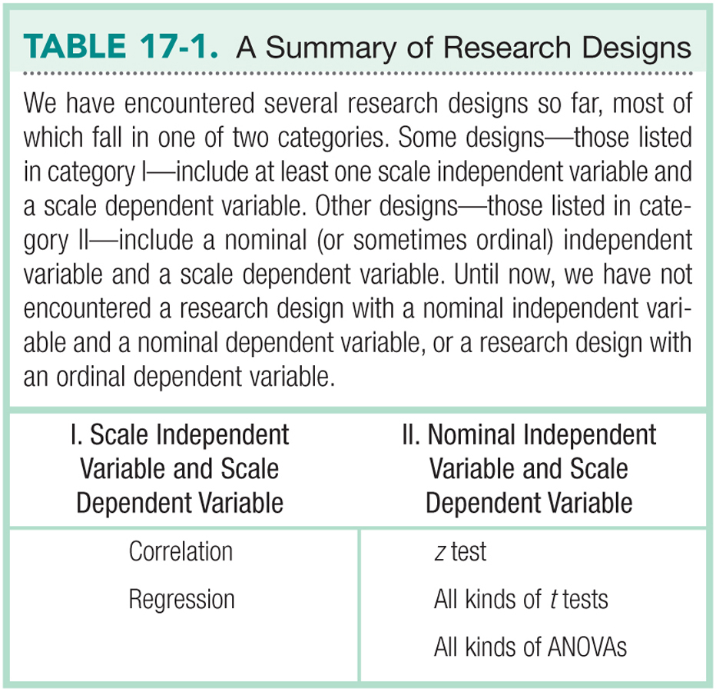

Slide 4
Nonparametrics
Specifically, for when the DV is NOT a scale variable.
DV is nominal (frequency counts of categories)
DV is ordinal (rankings of categories)
IV is usually also one of these things as well.

Slide 5
Nonparametrics
Used when the sample size is small
Used when underlying population is not normal

Slide 6
Limitations of Nonparametric Tests
Cannot easily use confidence intervals or effect sizes
Other things I don’t think are true:
Have less statistical power than parametric tests
Nominal and ordinal data provide less information

Slide 7
Two types of Chi-Square
Goodness of fit test
For when you have ONE nominal variable
Independence test
For when you have TWO nominal variables

Slide 8
Goodness of Fit Test
Step 1: list the variable involved
Statistics classes

Slide 9
Goodness of Fit Test
Step 2: chi-square is all about expected fit
How much does the the data match what we would expect if these categories were assigned by chance?

Slide 10
Goodness of Fit Test
Step 2:
Observed statistic test categories match the expected variables (O = E)
Observed statistic test categories do not match the expected variables (O/=E)

Slide 11
Goodness of Fit Test
Step 3: List the observed and expect values
List the df

Slide 12
Goodness of Fit Test
Two ways to do expected values:
N (total number of people) / Number of categories
OR
N (total number of people) * expected proportion for that category

Slide 13
Goodness of Fit Test
 | PSY 200 | SOC 302 | MTH 340
A grades | 25 | 18 | 11
observed
 | PSY 200 | SOC 302 | MTH 340
A grades | 18 | 18 | 18
expected

Slide 14
Goodness of Fit Test
df
Number of Categories – 1
3 – 1 = 2

Slide 15
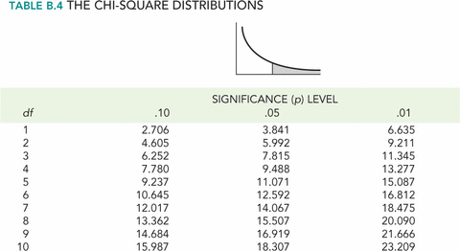
Goodness of Fit Test
Step 4: Cut off score (5.992)
Use a chi-square table

Slide 16
Goodness of Fit Test
Step 5: List chi-square = 5.44
http://vassarstats.net/csfit.html

Slide 17
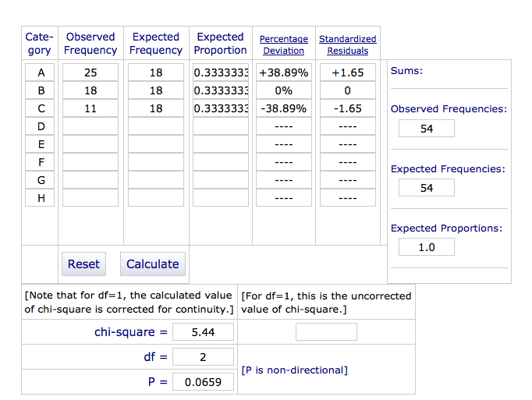

Slide 18
Goodness of Fit Test
Step 6:
Is the found chi-square value > the cut off chi-square value?
This test is like F – everything is squared, so all values are positive.
Nope! Same number of As in each class.

Slide 19
Independence Test
Independence test for two nominal variables
Are the observed values equal to the expect values given the combinations of categories?

Slide 20
Independence Test
Step 1: list the variables involved.
Professors and grade distributions

Slide 21
Independence Test
Step 2: chi-square is all about expected fit
How much does the the data match what we would expect if these categories were assigned by chance?

Slide 22
Independence Test
Step 2:
Observed statistic grades for each professor match the expected variables (O = E)
Observed statistic grades for each professor do not match the expected variables (O/=E)

Slide 23
Independence Test
Step 3: List the observed and expect values
List the df

Slide 24
Independence Test
df = (3-1)(3-1) = 4

Slide 25
Independence Test
Expected values:
E = R*C / N
E = expected
R = row total
C = column total
N = total of everything

Slide 26
Independence Test
observed
 | A | B | C | ROW TOTALS
Prof 1 | 5 | 6 | 5 | 16
Prof 2 | 12 | 4 | 3 | 19
Prof 3 | 11 | 9 | 3 | 23
COLUMN TOTALS | 28 | 19 | 11 | N = 58
 | A | B | C | ROW TOTALS
Prof 1 | 16*28/58 | 16*19/58 | 16*11/58 | 16
Prof 2 | 19*28/58 | 19*19/58 | 19*11/58 | 19
Prof 3 | 23*28/58 | 23*19/58 | 23*11/58 | 23
COLUMN TOTALS | 28 | 19 | 11 | N = 58
expected

Slide 27
Independence Test
 | A | B | C | ROW TOTALS
Prof 1 | 7.72 | 5.24 | 3.03 | 16
Prof 2 | 9.17 | 6.22 | 3.60 | 19
Prof 3 | 11.10 | 7.53 | 4.36 | 23
COLUMN TOTALS | 28 | 19 | 11 | N = 58

Slide 28
Independence Test
Step 4: Cut off score (9.488)
Use a chi-square table

Slide 29
Independence Test
Step 5: List chi-square = 4.82
http://vassarstats.net/newcs.html

Slide 30
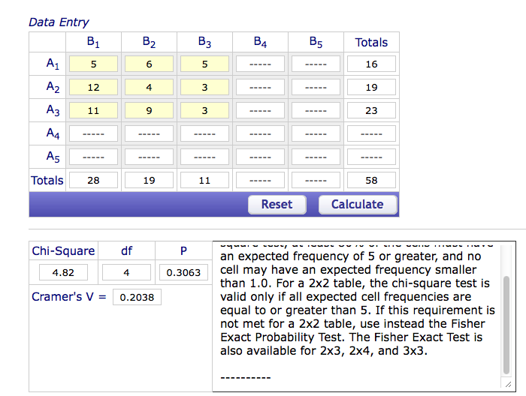
Independence Test

Slide 31
Independence Test
Step 6:
Is the found chi-square value > the cut off chi-square value?
This test is like F – everything is squared, so all values are positive.
Nope! Same number of ABC grades for each professor.

Slide 32
Cramer’s V (phi)
The effect size for chi-square test for independence
df row/column = smaller number of (R-1) or (C-1)

Slide 33
